Slide 1
SESSION – 3 LEARNING
Notes:
1

Slide 2


Objectives
Machine learning basics
Supervised learning
Notes:
Results of first essay is close to complete
2

Slide 3
TRADITIONAL SENTIMENT ANALYSIS
Sentiment analysis done so far
Corpus of sentiments found in word_sentiment.csv
Hard-coded algorithm – user coded definition of what a good and a bad sentiment is for all words
Problems
What do you do if the word does not exist in your corpus of sentiment ?
ML to find sentiment of un known word
How do you capture the nuances of framing a sentence ? Eg. Not good
ML to find sentiment of sentence
Traditional Algorithm:
Find the word in the word_sentiment.csv file and get its sentiment
Input Word
Output sentiment
Notes:
Platforms
3

Slide 4
Machine Learning
ML approach
No hardcoded definition of what a good and bad sentiment is
Data- driven classification - learn from example data
Supervised Learning
Given label data - examples of words with good sentiment and words with bad sentiment
Availability of labelled data - Integrated social media features
Classification (discreate/ categorial) and regression (regression)
Un-supervised learning
Un-supervised Learning - No-labeled data available
Clustering and association
ML MODEL
( Weights and biases)
Input Word
Output sentiment
Prediction
Notes:
Association is find out what goes with what ( market basket analysis)
4

Slide 5
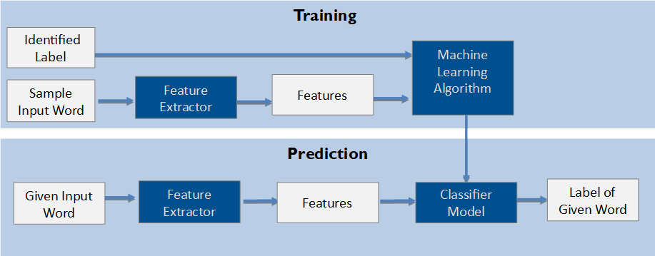
Supervised LEARNING
Start with the labelled examples
Learn from the examples what defines a good and a bad sentiment
Training the algorithm
Step 1 – Feature Extraction: extract features of the example words eg. length of word
Step 2 – ML Algorithm to define how the features are related to the labels eg. regression
Step 3 – ML algorithm: The established relationship between the example words and its labels through its features eg. sentiment = .3 * length(word) + b
Prediction
Step 1 – Feature extraction of the given word eg. “Good” - length of the word = 4
Step 2 – Apply classifier model to predict the label eg. If .3*4 + c > 0.5 it is good sentiment
Notes:
5

Slide 6

FEATURE EXTRACTION
Selecting the right features and determining how to encode them
Trial and error or theories determine what features to use
Overfitting
Too many features, too little data
Model captures idiosyncrasies of the training data
Difficult to generalize
Error analysis : divide the labeled example data set into training and testing data sets
Feature identification and optimization: create dev-test sample from the training set
Notes:
6

Slide 7
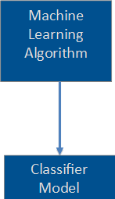
ML Algorithm and classifier model
Several algorithms from regressions, decision-trees, SVM, clustering etc.
Most modules treat them as black boxes eg. NLTK module
Naive Bayes Method
Calculate the most likely label given a set of features
Naive Bayes assumption – feature independence
Easy to combine the contributions of the features i.e. P(f₁...f_{n}/label)=∏_{i}P(f_{i}/label)
Label likelihood, P(l/f₁...f₂) = P(l)*∏_{i}P(f_{i}/l)
Problem of zero counts
Naive assumption and possibility of double counting
The end: importance of labelled data and sample
Notes:
7

Slide 8
The end: Labelled data
Importance of labelled data
Image-net project (image-net.org)
48000 mturk workers across 167 countries to produce a labelled set of a billion images
Neural network – 24 m nodes, 140 m parameters, 15 b connections
3 years of a child – current state of image recognition
Notes:
8

Slide 10
Traditional Algorithm:
Find the word in the word_sentiment.csv file and get its sentiment
Input Word
Output sentiment
Training
Identified Label
Machine Learning Algorithm
Feature Extractor
Features
Sample Input Word
Feature Extractor
Prediction
HTTP Response with http://www.hec.fr
data in HTML, CSS and JavaScript formats
Content information
Given Input Word
Feature Extractor
Features
Classifier Model
Label of Given Word

